Slide 1
Modeling the pandemic – The SIR model and its variants
Now that we have reviewed some basic epidemiological concepts and that we have briefly talked about scientific modeling in general, we are going to start discussing epidemic modeling specifically
More precisely, we are going to study the SIR model and its variants
This is the basic model of the epidemiology of infectious disease and most of the more complicated models that are used in practice are based on it

Slide 2
Modeling the pandemic – The SIR model and its variants
The key feature of this family of models is that they divide the population into several classes or compartments and then model the transition between them
This is why they are called “compartment models”
The SIR model divides the population into 3 compartments: S(usceptibles)-I(nfected)-R(ecovered)

Slide 3
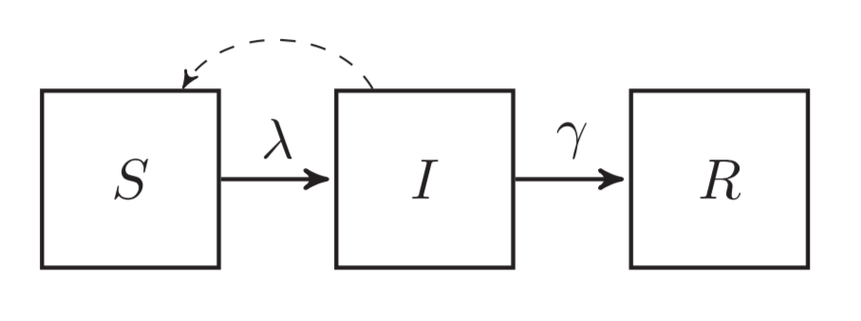
Modeling the pandemic – The SIR model and its variants
The SIR model

Slide 4
Modeling the pandemic – The SIR model and its variants
N = S + I + R = total population
π = probability of being infected upon exposure
ρ = contact rate (think of it as the average number of contacts per day people have)
So β = πρ is the rate at which infected individuals would successfully transmit the virus if everyone they had a contact with were susceptible
In that case, the daily number of new infections would be βI

Slide 5
Modeling the pandemic – The SIR model and its variants
However, not everyone is actually susceptible, so in reality the daily number of new infections is less than that because only some of the contact infected people have can result in transmission of the virus
When you take that into account, the daily number of new infections becomes βI = Sλ with λ = β = force of infection
This means that the daily change in the number of susceptible is equal to -βI
$\frac{S}{N}$
$\frac{I}{N}$
$\frac{S}{N}$

Slide 6
Modeling the pandemic – The SIR model and its variants
But people also recover and thus leave the I(infected) compartment to move into the R(ecovered) compartment
γ = recovery rate (think of it as the probability of recovering during any given day)
So the daily change in the number of recovered is γI
This also affects the daily change in the number of infected, which becomes βI - γI
$\frac{S}{N}$

Slide 7
Modeling the pandemic – The SIR model and its variants
The recovery rate γ is related to the average duration D of the infectious period, i. e. the time people spend in the I(nfected) compartment
γ =
This is just what it means to sau that γ is the probability of recovering during any given day
$\frac{1}{D}$

Slide 8
Modeling the pandemic – The SIR model and its variants
If we put all this together, we get the following system of differential equations
$\frac{dS}{dt}=−βI\frac{S}{N}$
$\frac{dI}{dt}=βI\frac{S}{N}−γI$
$\frac{dR}{dt}=γI$

Slide 9
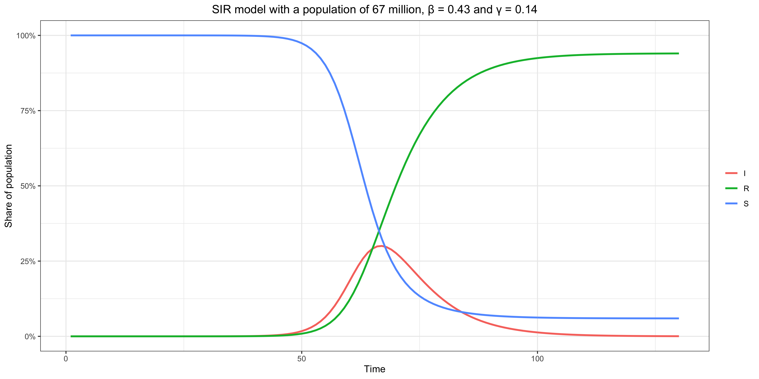
Modeling the pandemic – The SIR model and its variants

Slide 10
Modeling the pandemic – The SIR model and its variants
Basic reproduction number and effective reproduction number in the SIR model
Note that the epidemic will start receding when the number of people in the infected compartment starts going down, i. e. or
This condition can be rewritten as
But is the average number of people that someone who is infected would infect during the course of the infectious period if everyone in the population were susceptible, i. e. the basic reproduction number
So is the effective reproduction number and the condition just means that the epidemic starts receding when the effective reproduction number falls below 1
$βI\frac{S}{N}−γI<0$
$βI\frac{S}{N}<γI$
$\frac{β}{γ}\frac{S}{N}<1$
$\frac{β}{γ}=βD$
$\frac{β}{γ}\frac{S}{N}$

Slide 11
Modeling the pandemic – The SIR model and its variants
This makes intuitive sense if you think about it, because the basic reproduction number depends on the rate of transmission β but also on D which is just 1/γ
Meanwhile, the effective reproduction number is just the product of the basic reproduction and the proportion of susceptible in the population
For instance, if the basic reproduction number is 3 and 1/3 of the population has been infected and has recovered, someone who is infected will on average infect 2 people so the I(nfected) compartment will continue to grow
But if 2/3 of the population has been infected and has recovered, he will only infect 1 person on average, because 2/3 of the people he interacts with are no longer susceptible so the I(nfected) compartment will stop growing

Slide 12
Modeling the pandemic – The SIR model and its variants
At the beginning of the epidemic, when almost everyone is susceptible, the epidemic grows exponentially (i. e. at constant rate)
However, this doesn’t last, because due to people getting infected and becoming immune R gradually goes down
But as we have seen, R = 1 + rT where T is the mean generation time (because the equations of the SIR model imply that the generation time follows an exponential distribution), so r = (R – 1) / T which decreases as R goes down and becomes < 0 when R < 1
So even in the SIR model, which as we’ll see is not very realistic, it’s not true that the epidemic grows exponentially except (approximately) at the beginning

Slide 13
Modeling the pandemic – The SIR model and its variants
The SIR model rests on unrealistic assumptions
Homogeneous population mixing
No one dies from the disease
No demography (i. e. nobody is born or dies from other causes)
Immunity doesn’t wane
Infection and recovery processes are assumed to take place at constant rate
No latency period between infection and infectiousness
Etc.

Slide 14
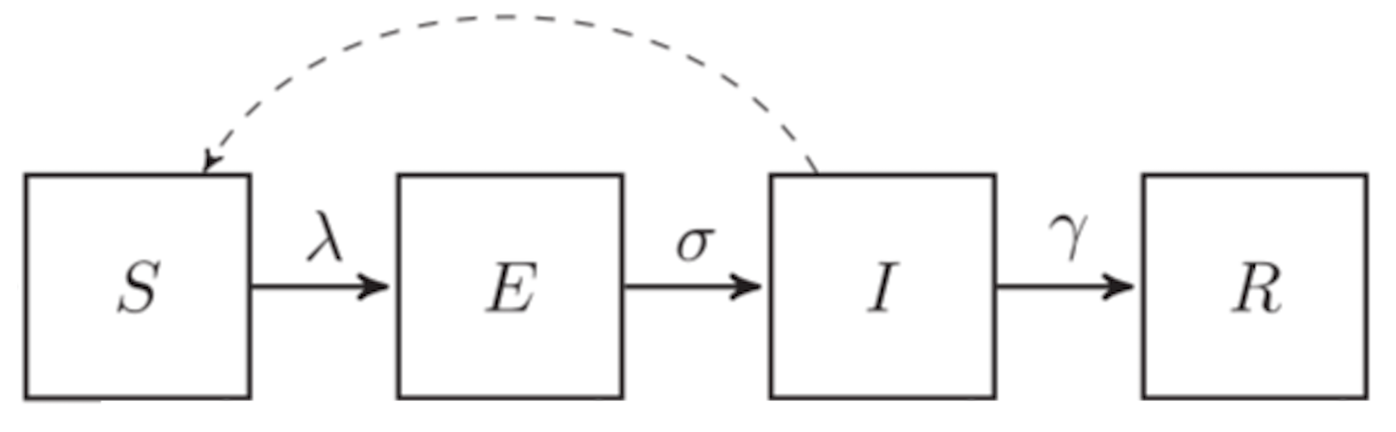
Modeling the pandemic – The SIR model and its variants
The SEIR model
$\frac{dS}{dt}=−βI\frac{S}{N}$
$\frac{dE}{dt}=βI\frac{S}{N}−σE$
$\frac{dI}{dt}=σE−γI$
$\frac{dR}{dt}=γI$

Slide 15
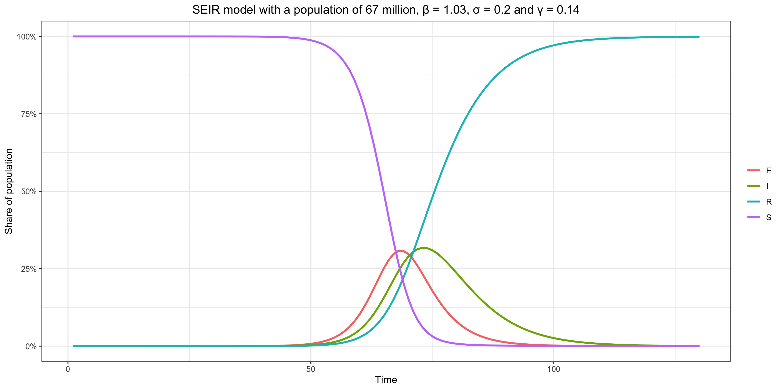
Modeling the pandemic – The SIR model and its variants

Slide 16
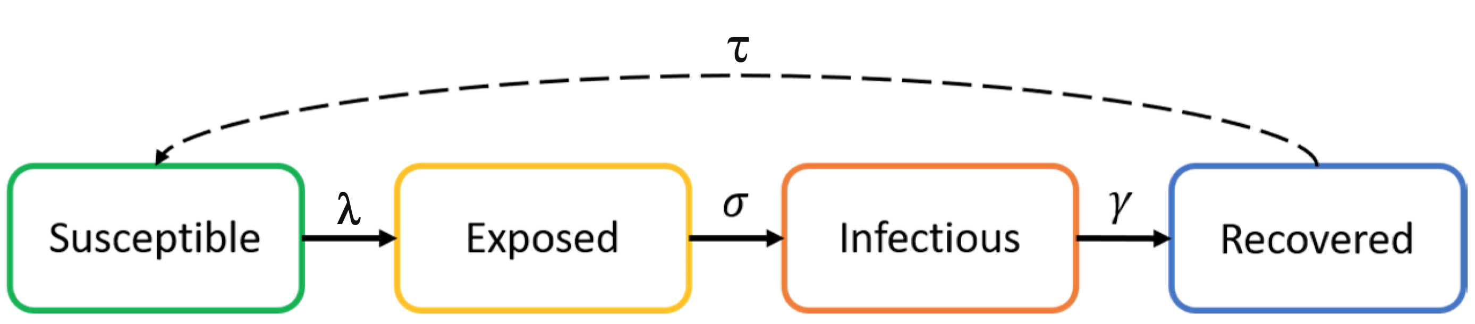
Modeling the pandemic – The SIR model and its variants
The SEIRS model
$\frac{dS}{dt}=τR−βI\frac{S}{N}$
$\frac{dE}{dt}=βI\frac{S}{N}−σE$
$\frac{dI}{dt}=σE−γI$
$\frac{dR}{dt}=γI−τR$

Slide 17
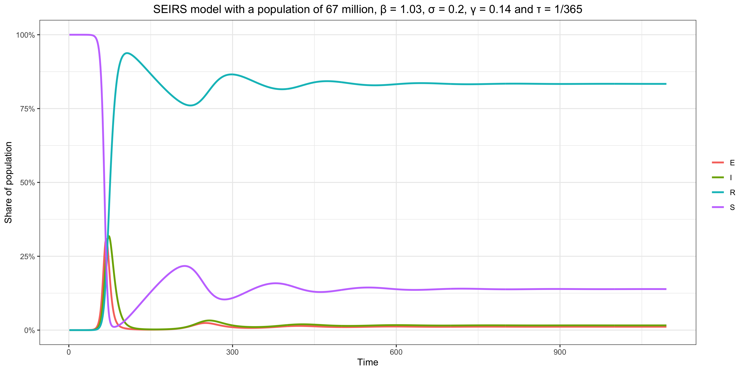
Modeling the pandemic – The SIR model and its variants

Slide 18
Modeling the pandemic – The SIR model and its variants
In the SIR/SEIR models, when R₀ > 1, a disease free equilibrium is eventually reached (i. e. the number of infectious people reaches zero and stays there forever)
In the SEIRS model, on the other hand, an endemic equilibrium is eventually reached (i. e. one in which the number of infectious people is constant but greater than zero)
So in this model, as long as R₀ > 1, the virus never disappears

Slide 19
Modeling the pandemic – The SIR model and its variants
Models with time-varying parameters
Note that the value of π, ρ (and therefore β) and γ do not just depend on the biological properties of the virus, but also on culture, people’s behavior, density, health care, etc.
This means that they can change over time
If people have different types of interactions, π and therefore β may change
If they have less interactions, ρ and therefore β will change

Slide 20
Modeling the pandemic – The SIR model and its variants
Therapeutics could change σ and γ, which could also vary depending on genetic differences between populations
Another thing that could conceivably affect them is masking if it reduces the viral inoculum and this affects the duration of infectiousness or the incubation period
The emergene of new variants with different biological properties could also change the value of those parameters

Slide 21
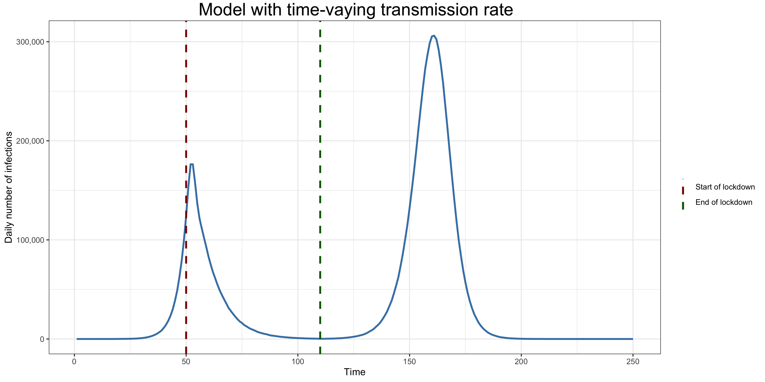
Modeling the pandemic – The SIR model and its variants

Slide 22
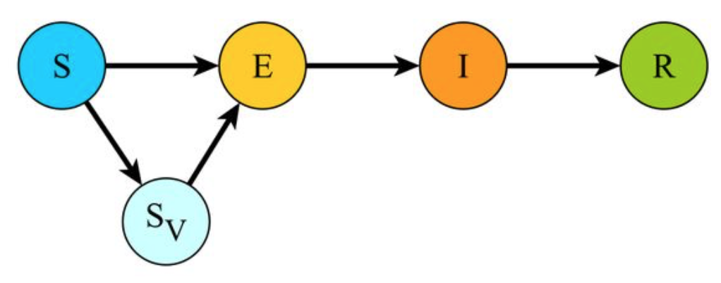
Modeling the pandemic – The SIR model and its variants
SEIR model with vaccination

Slide 23
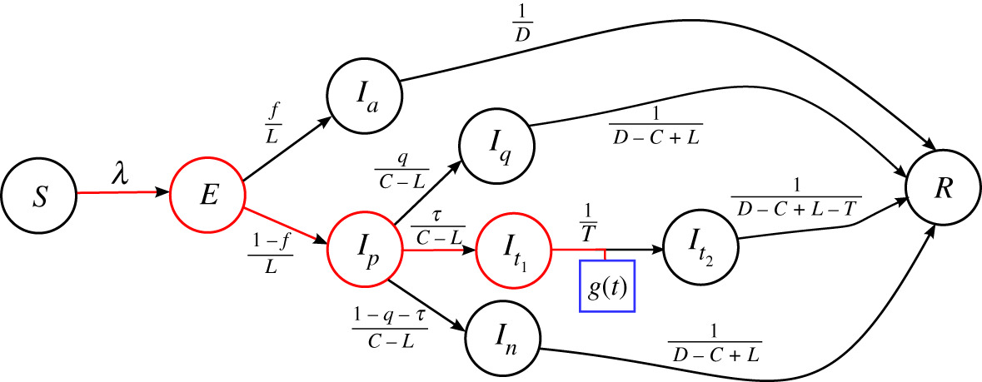
Modeling the pandemic – The SIR model and its variants
This framework is very flexible
(James P. Gleeson et al., “Calibrating COVID-19 susceptible-exposed-infected-removed models with time-varying effective contact rates”, Philosophical Transactions of the Royal Society A, 2021)

Slide 24
Modeling the pandemic – The SIR model and its variants
Problems with the standard modeling framework
Although very flexible, this framework has arguably not been particularly successful during the pandemic (https://evaluation-modelisation-covid.github.io/france/)
Because of the Quine-Duhem thesis, there are always ways to save it, but should it be saved?
It might be worth exploring alternative and that’s what we’re going to do now

Slide 25
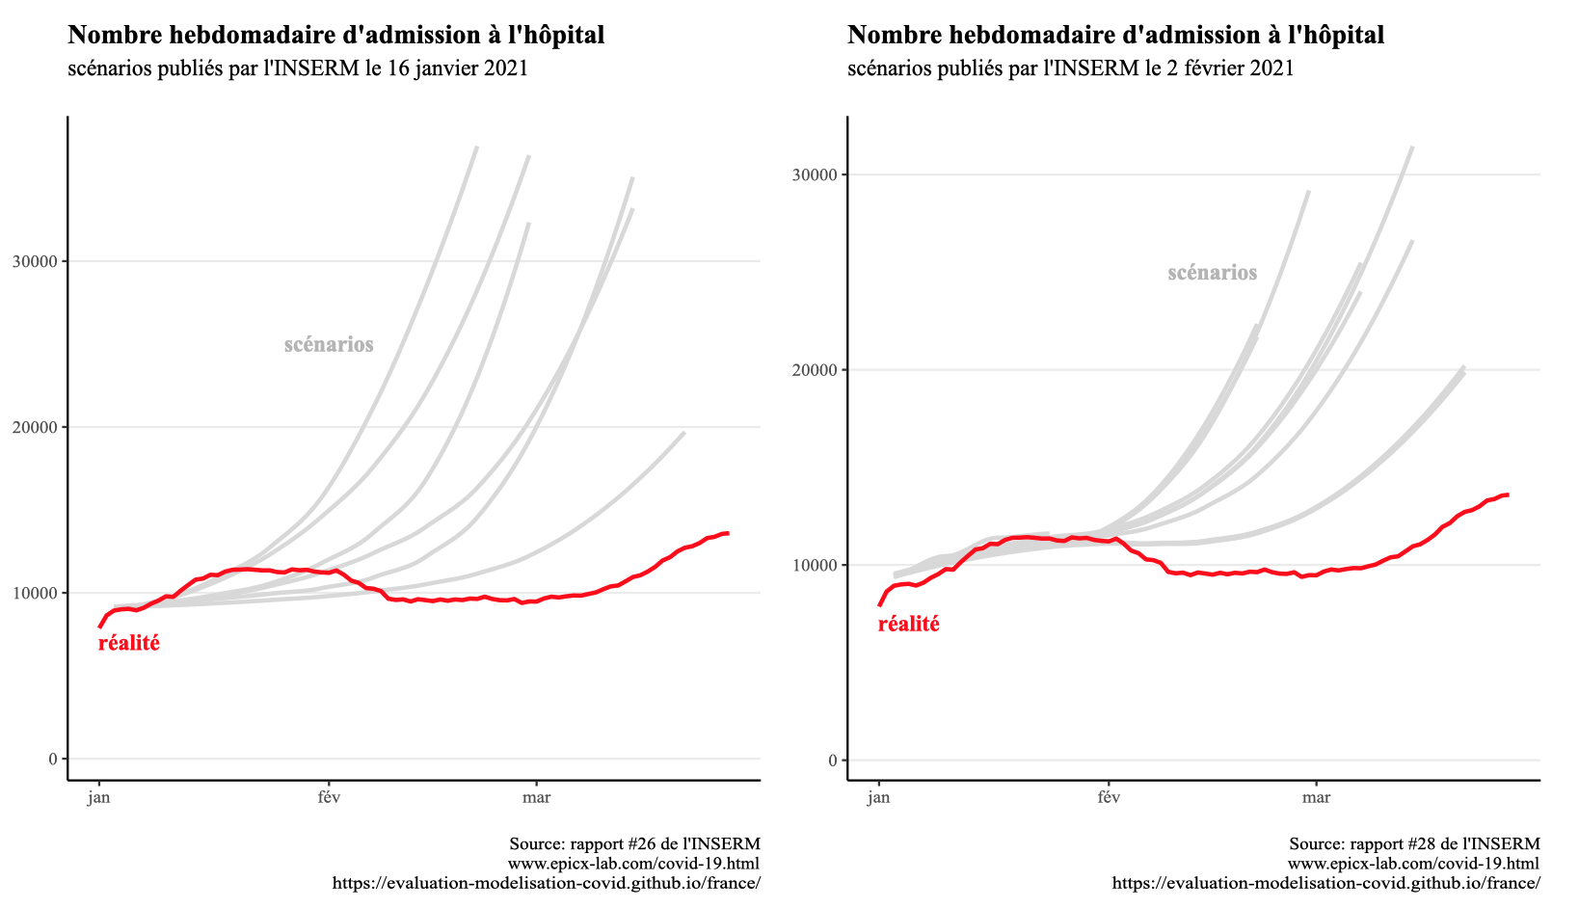
Modeling the pandemic – The SIR model and its variants

Slide 26
Modeling the pandemic – The SIR model and its variants
One common argument in defense of the standard framework is that people’s voluntary behavioral changes were not sufficiently taken into account
Indeed, in many cases, the evidence is consistent with the hypothesis that voluntary behavioral changes have done a lot of work

Slide 27
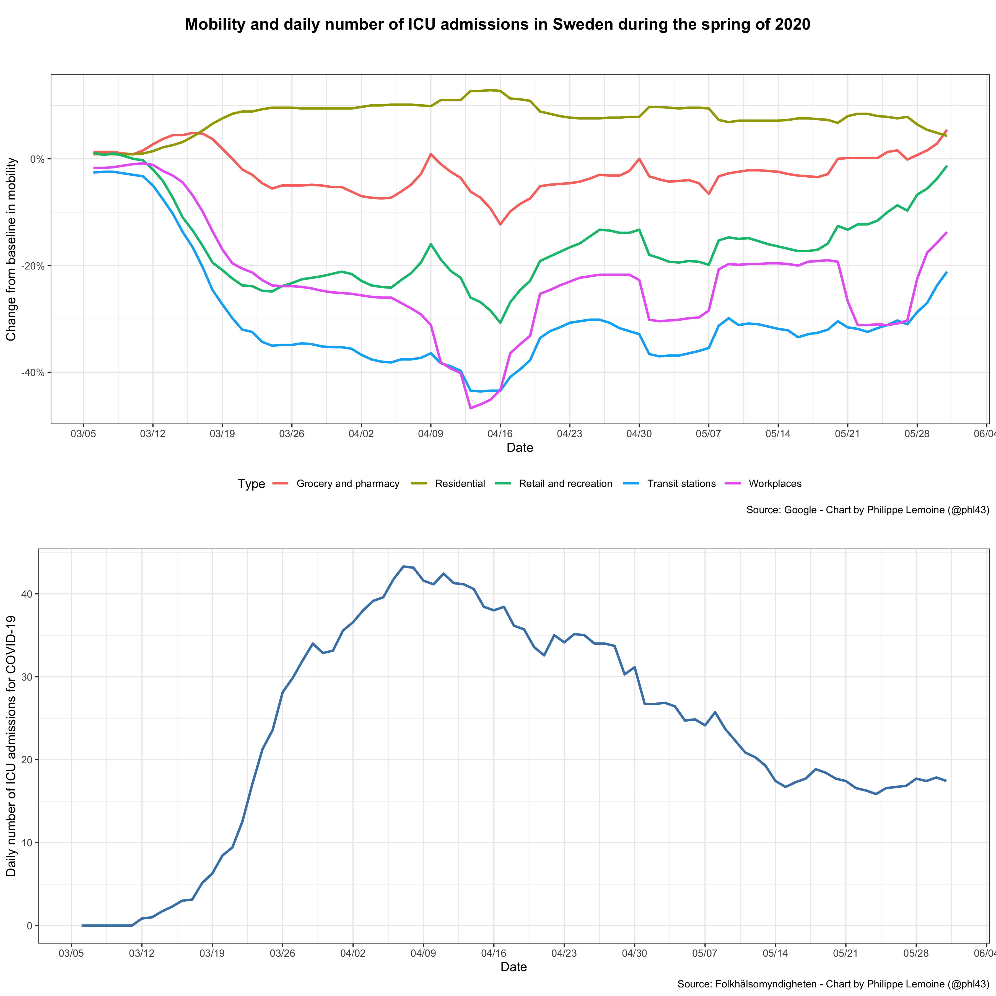
Modeling the pandemic – The SIR model and its variants

Slide 28
Modeling the pandemic – The SIR model and its variants
However, based on the data we have (which are very imperfect), this doesn’t seem to explain everything
There are many cases where the reproduction number underwent wild fluctuations without any evidence that people significantly changed their behavior

Slide 29
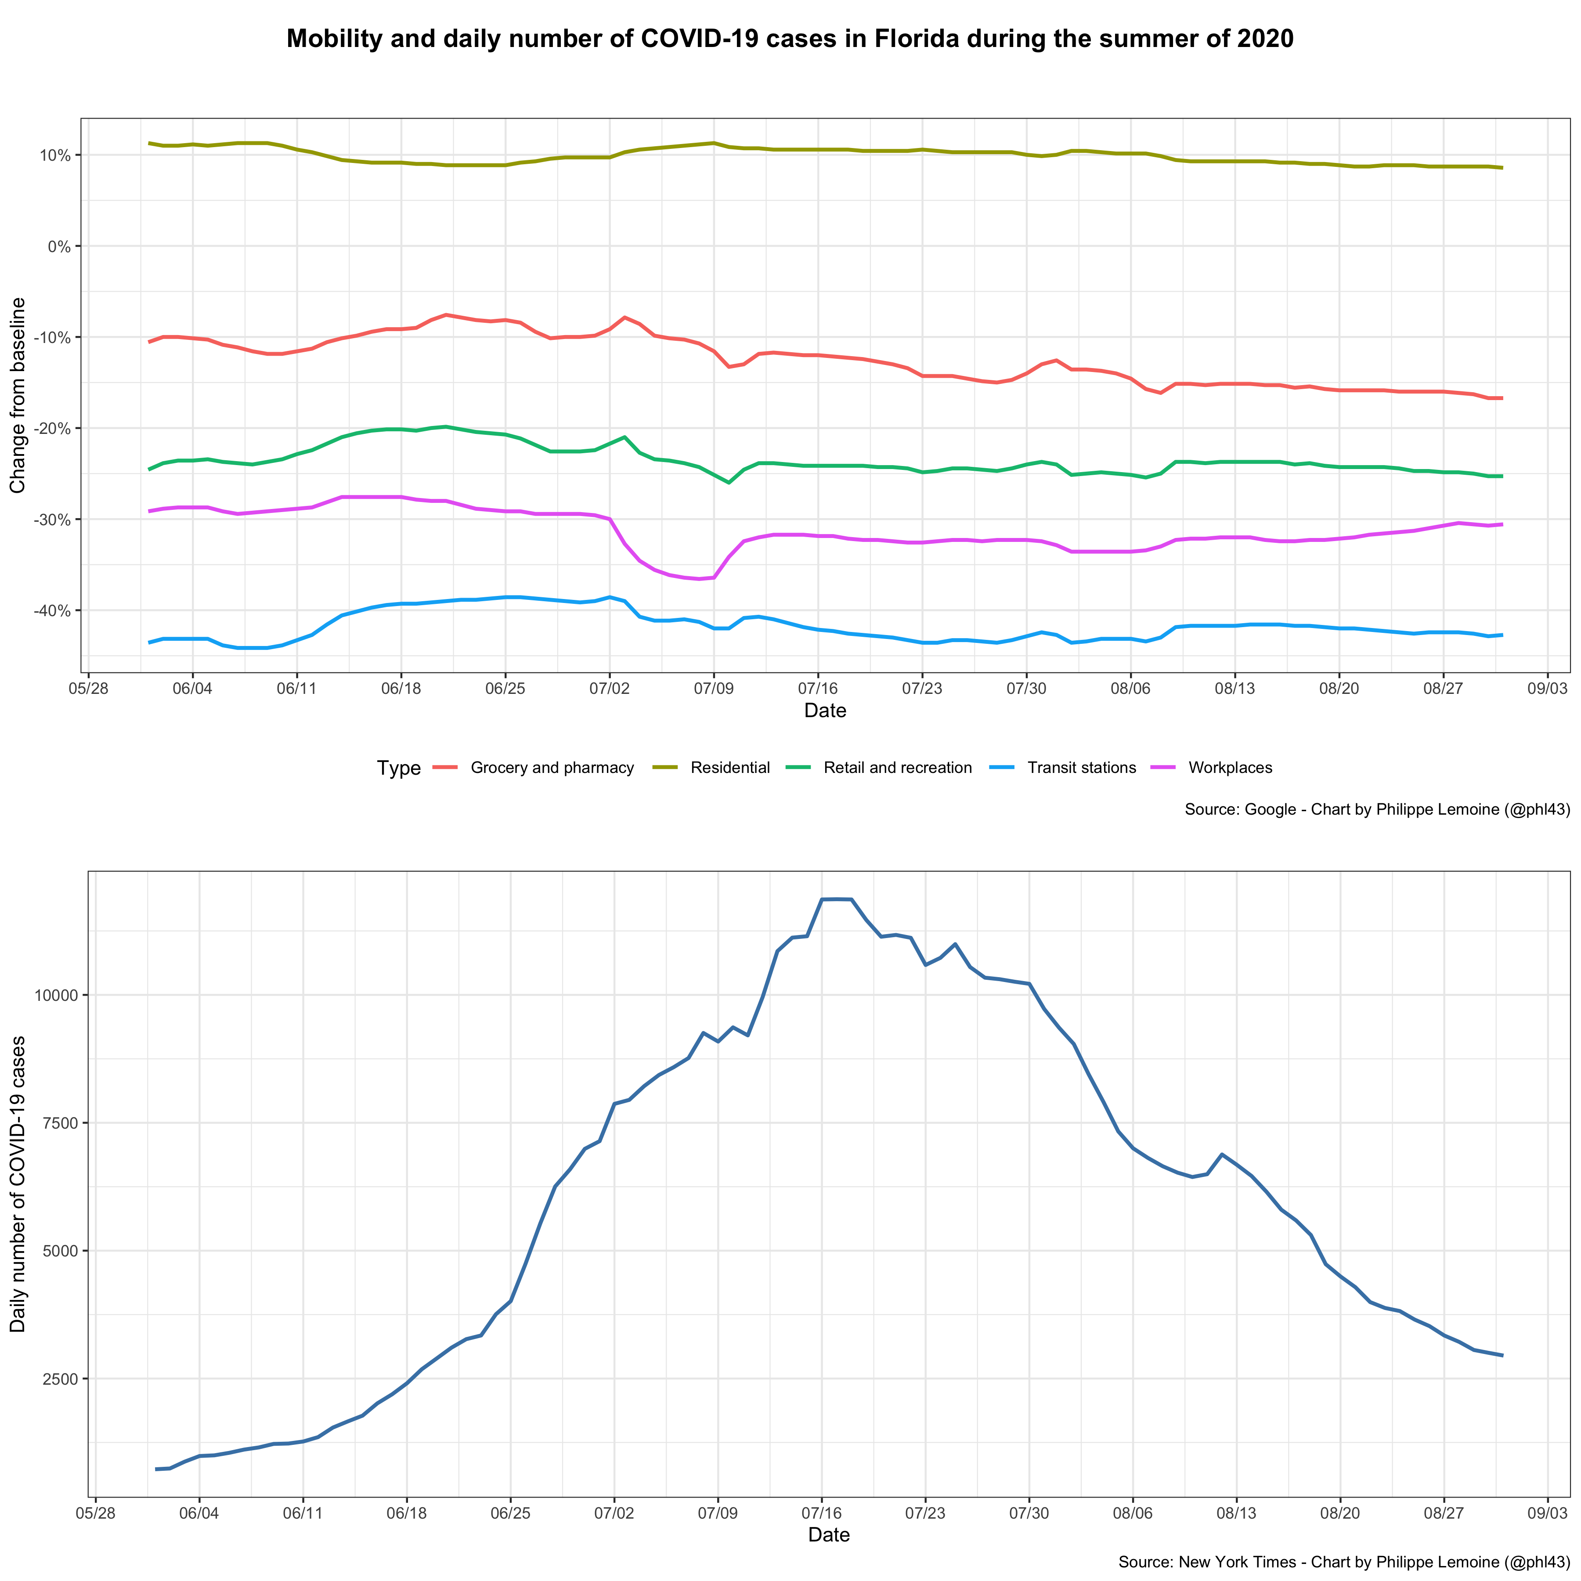
Modeling the pandemic – The SIR model and its variants

Slide 30
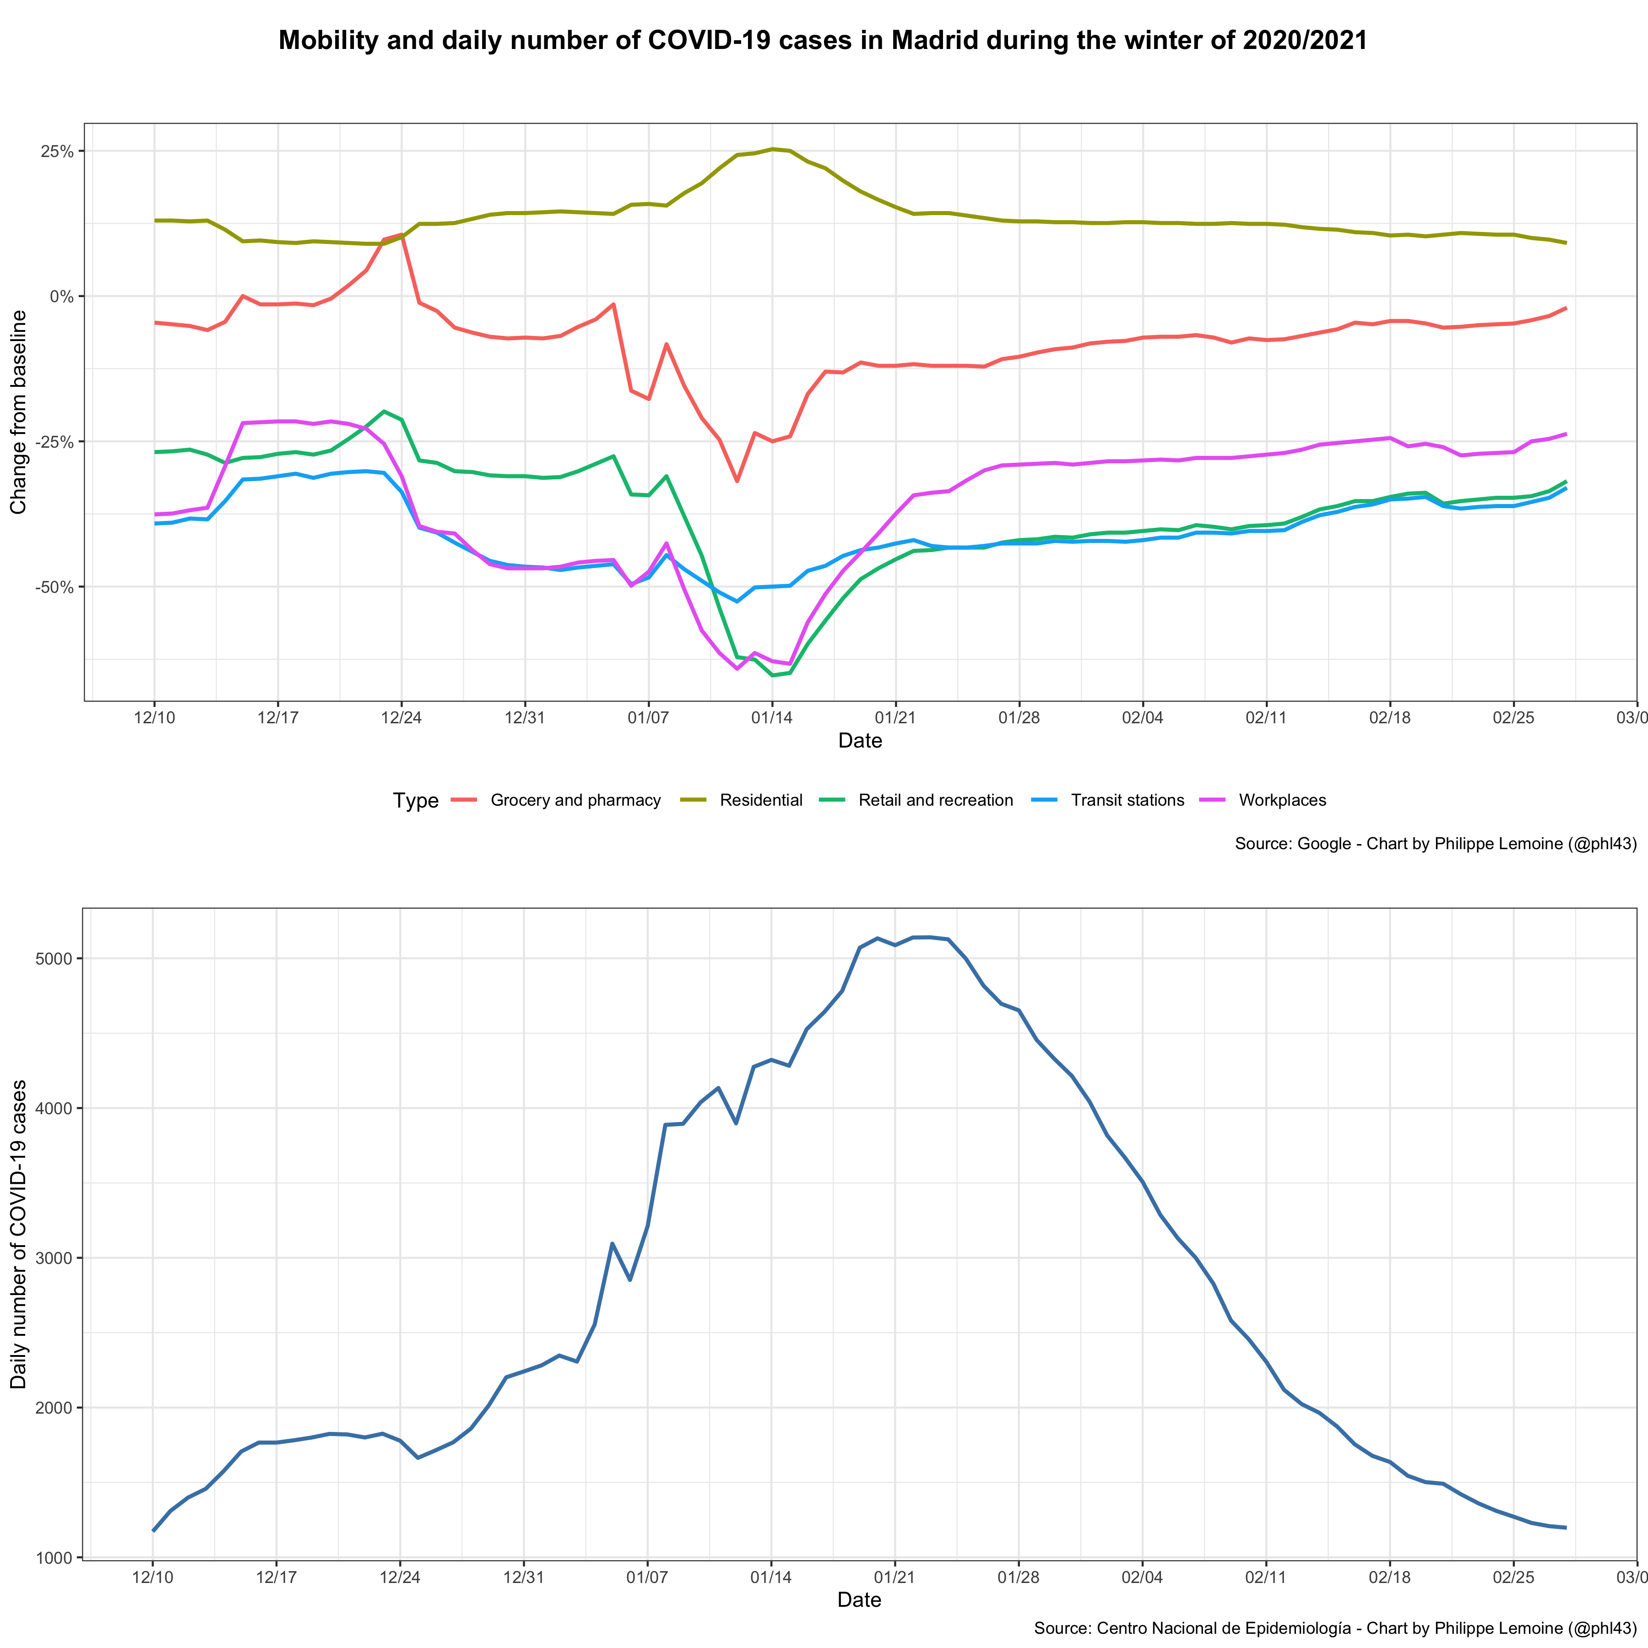
Modeling the pandemic – The SIR model and its variants

Slide 31
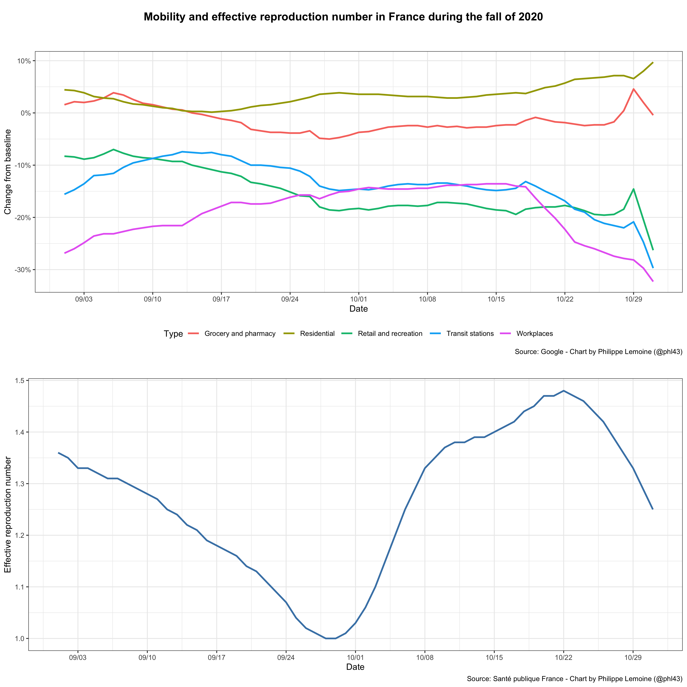
Modeling the pandemic – The SIR model and its variants

Slide 32
Modeling the pandemic – The SIR model and its variants
This evidence is suggestive but not conclusive
Various hypotheses could explain those data that don’t require that we question the basic validity of the standard framework (remember Duhem-Quine again!)
However, they sound very ad hoc, so again it seems worthwhile to explore alternatives

Slide 33
Modeling the pandemic – The SIR model and its variants
Could population structure be the explanation?
As we have seen, traditional models assume that the population is homogeneous mixing, but this is completely unrealistic
In reality, the virus spreads on a network, whose topology depends on people’s patterns of interaction
Maybe this can explain why the reproduction number sometimes undergoes large fluctuations in the absence of behavioral changes
One hypothesis that intuitively could have make this true is that the network on which the virus is spreading has “community structure”: it’s structure in subnetworks that are internally well connected but only loosely connected to each other

Slide 34
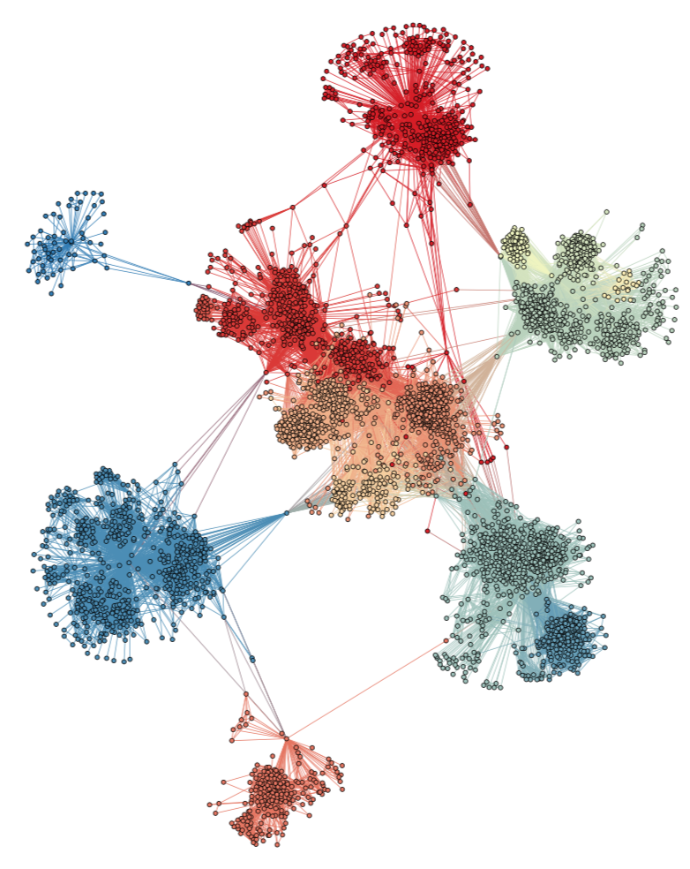
Modeling the pandemic – The SIR model and its variants

Slide 35
Modeling the pandemic – The SIR model and its variants
Since parts of the network are probably well-approximated by homogeneous mixing populations, we could model that as a network of linked SIR-type models where people can travel from one subpopulation to another
To see what happens when the network has community structure, we can randomly generate a network of subpopulations in such a way that it will be divided into subnetworks that are internally well-connected but only loosely connected to each other

Slide 36
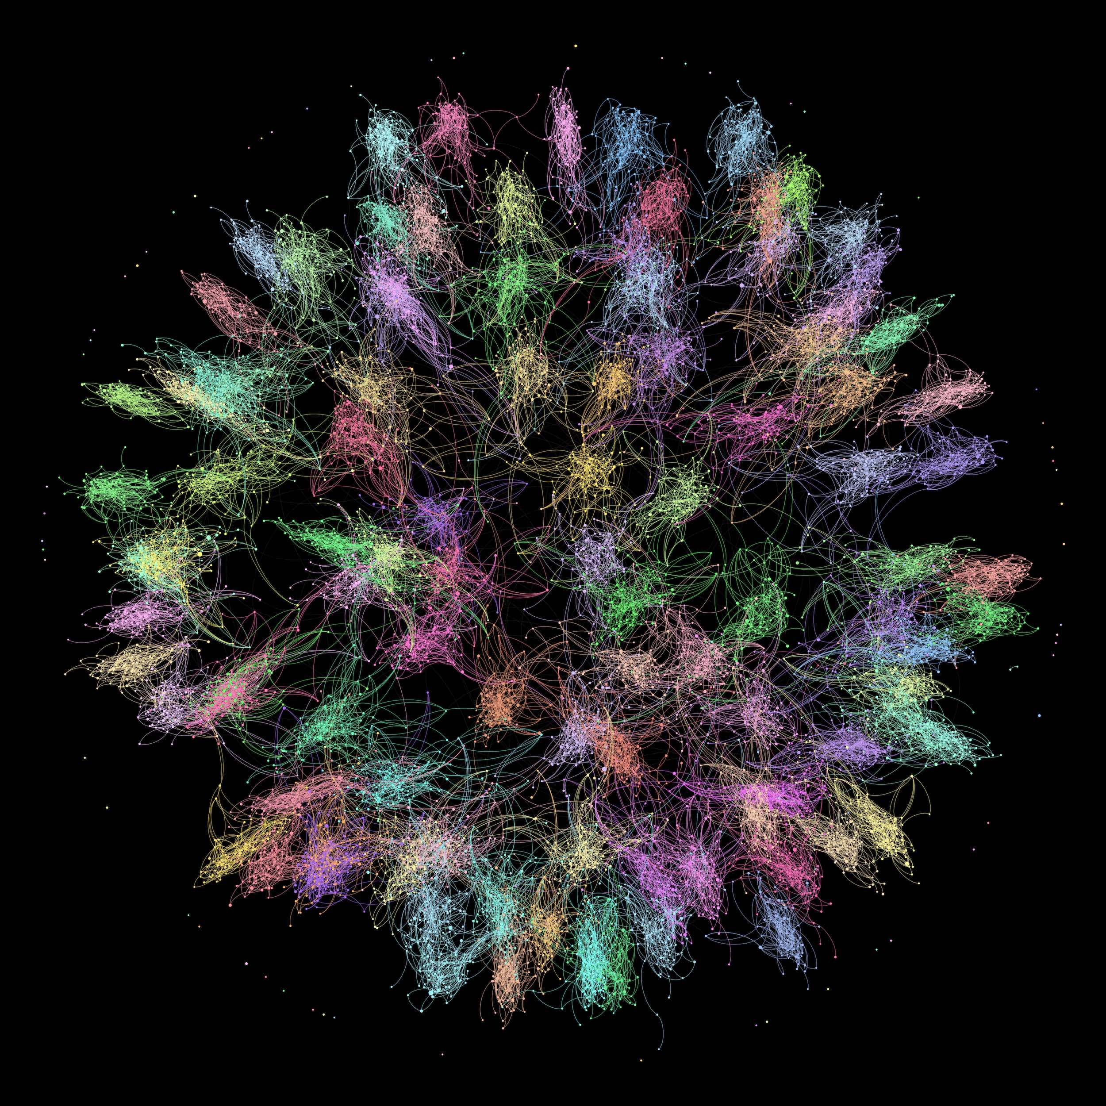
Modeling the pandemic – The SIR model and its variants

Slide 37
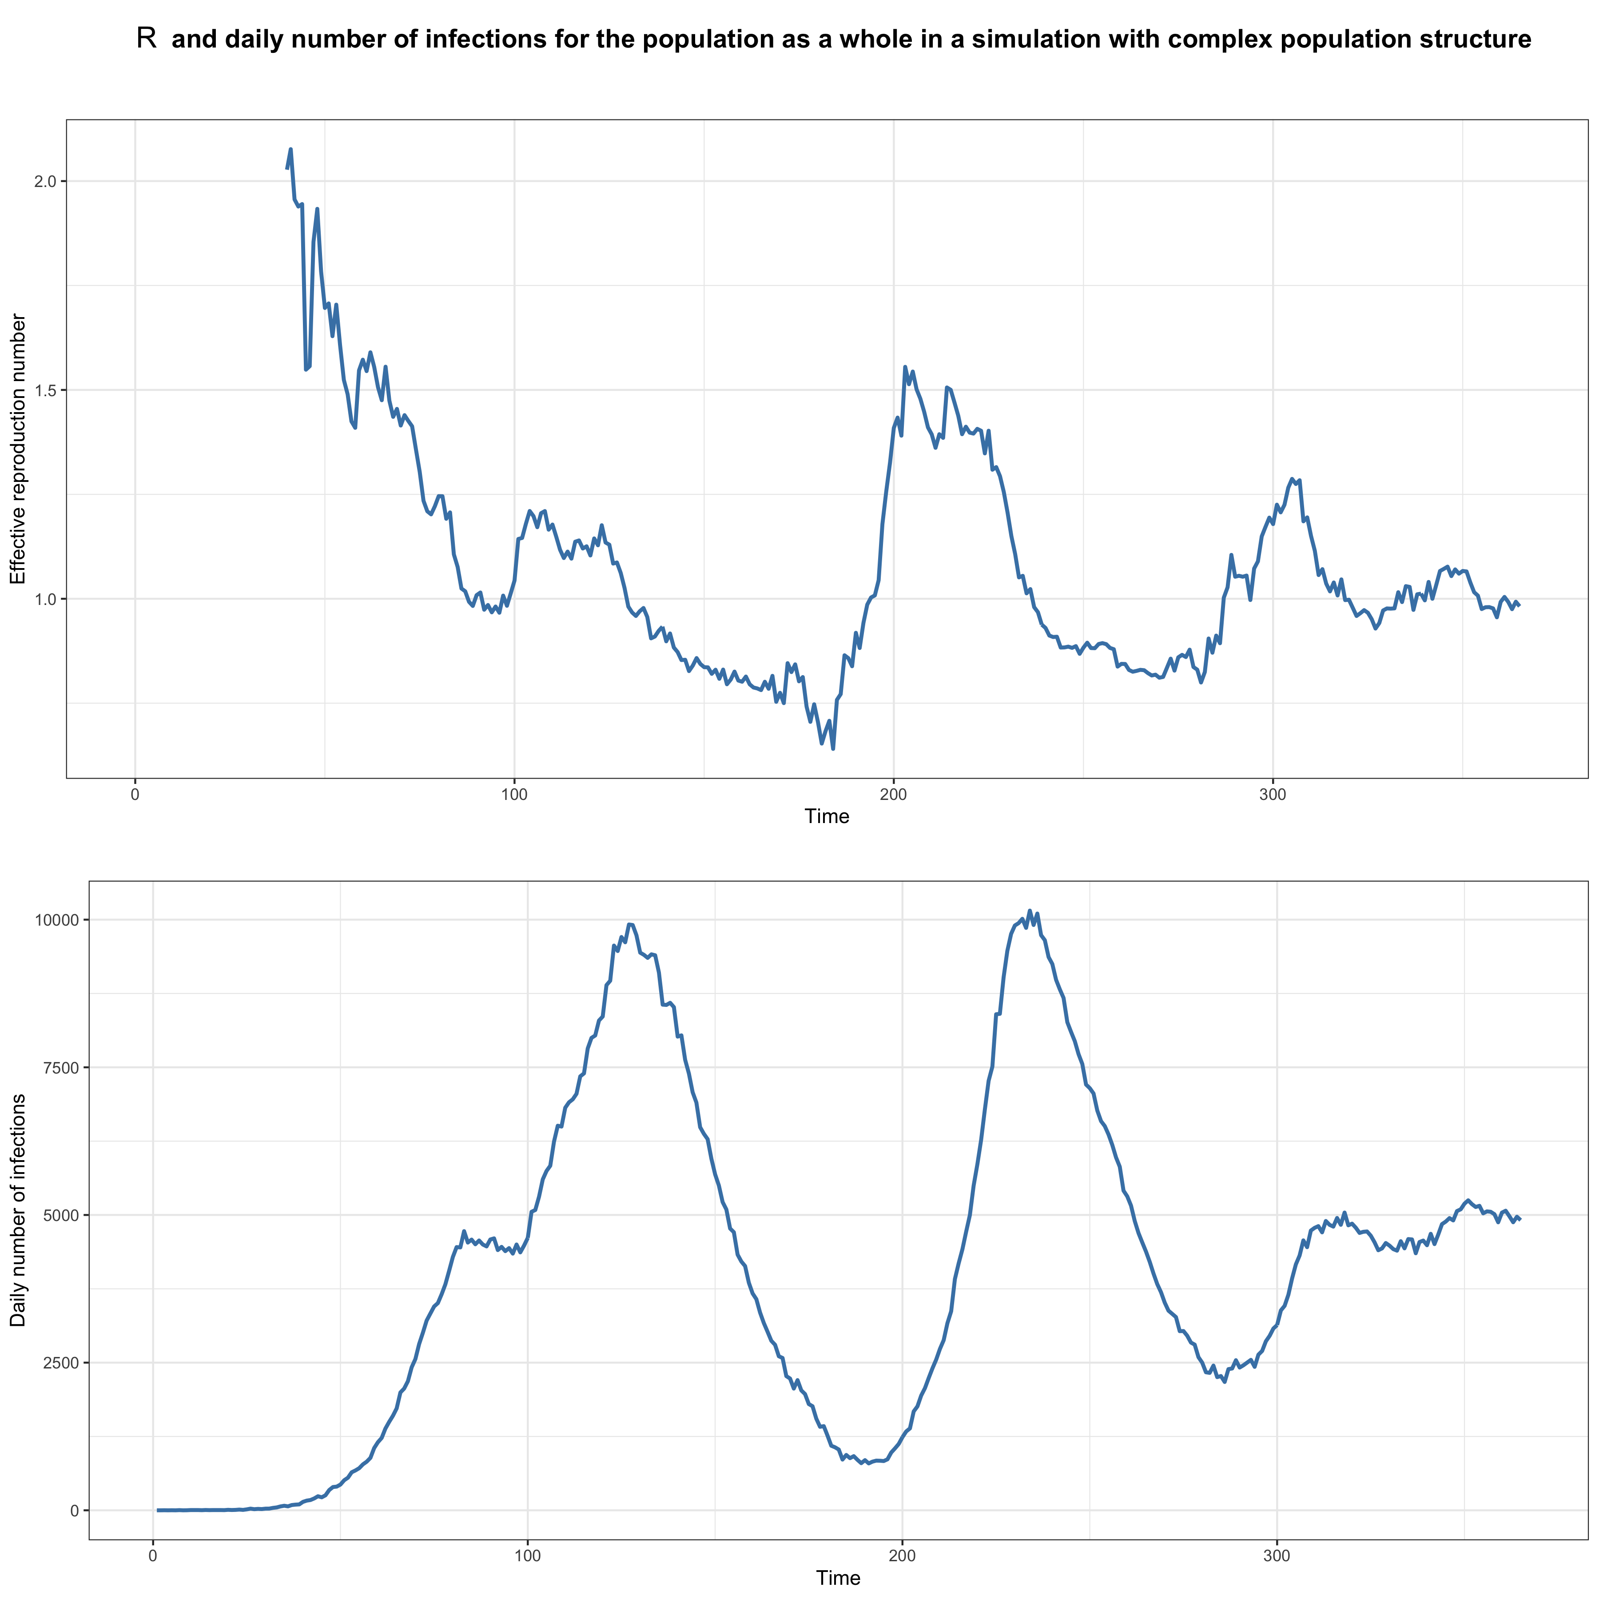
Modeling the pandemic – The SIR model and its variants

Slide 38

Modeling the pandemic – The SIR model and its variants

Slide 39
Modeling the pandemic – The SIR model and its variants
In this simulation, in each subnetwork, there are on average only 5 subpopulations that are connected to a subpopulation in another subnetwork
Moreover, the probability that a person who is infected in one of those subpopulations will travel to a subpopulation in another subnetwork is only 1 in 10,000
But things would be different if there were less connectivity between the subnetworks

Slide 40
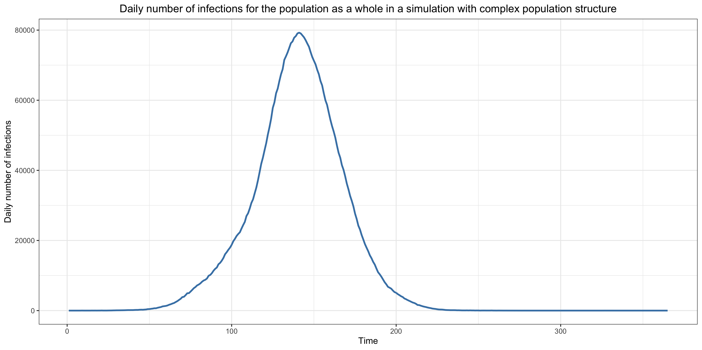
Modeling the pandemic – The SIR model and its variants

Slide 41
Modeling the pandemic – The SIR model and its variants
So the fact that, if the network has the right topology, we can get the kind of fluctuations we have observed in real life does not mean that population structure is the actual explanation of those fluctuations
In order to know that, we’d have to collect data bearing directly on that and check what topology the actual network has, which hasn’t been done yet and is very difficult
But it’s at least a plausible hypothesis and, if it were true, it would have many important implications such as the fact that R is largely meaningless at the aggregate level and that predicting the epidemic beyond the short-run is very difficult and arguably even impossible

Slide 42
Modeling the pandemic – The SIR model and its variants
Of course, even if that hypothesis is true, it doesn’t mean that it’s the only explanation for the data and this is even very unlikely
Furthermore, although we can’t tell whether this hypothesis is true, it would explain other surprising phenomena
In particular, it could explain why the transmission advantage of new variants fluctuates so much, and has tended to go down over time

Slide 43
Modeling the pandemic – The SIR model and its variants
As we shall see later, it may also mean that the techniques we’re using to estimate the effects of government interventions are not reliable
Again, this hypothesis may be false, but the fact that it may also be true and that we can’t rule it out illustrates the fact that, unlike climate models for instance, epidemiological models don’t rest on a firm theoretical foundation that we can be reasonably certain applies to the world
So we should be cautious and take everything we infer from those models with a huge grain of salt

